Slide 1
Emotion Recognition from Speech
1 / 8

Slide 2
Project Overview
Goal: Automatically detect human emotions from speech audio Dataset: Toronto Emotional Speech Set (TESS)
Features: Mel Frequency Cepstral Coefficients (MFCCs)
Models: Random Forest, SVM, CNN Neural Network
Emotions Detected: Happy, Sad, Angry, Fear, Neutral, Disgust, Surprise
Happy
Sad
Angry
Fear
Neutral
Disgust
Surprise
Emotion Recognition from Speech
Muzamal, Faraz, Ans

Slide 3
Methodology
Data Collection
TESS dataset (~2,800 audio samples)
Feature Extraction
2
3
40 MFCC coefficients per file
Model Training
2
CNN(Three Conv1D layers with dropout)
Emotion Recognition from Speech
Muzamal, Faraz, Ans

Slide 4
Model Comparison
Decision Tree: 63.80% accuracy
Support Vector Machine: 82% accuracy
CNN Neural Network: 85% accuracy
The CNN model significantly outperforms traditional
machine learning approaches for this task.
85%
68%
82%
Decision Tree
SVM
CNN
Emotion Recognition from Speech
Muzamal, Faraz, Ans
4 / 8

Slide 5
CNN Architecture
Input shape: (40, 1)
▼ Conv1D Layer (64 filters, kernel_size=5, padding='same')
▼ ReLU Activation
▼ Dropout (0.1)
▼ MaxPooling1D (pool_size=4)
▼ Conv1D Layer (128 filters, kernel_size=5, padding='same')
▼ ReLU Activation
▼ Dropout (0.1)
▼ MaxPooling1D (pool_size=4)
▼ Conv1D Layer (256 filters, kernel_size=5, padding='same')
▼ ReLU Activation
▼ Dropout (0.1)
▼ Flatten
▼ Dense Layer (8 units)
▼ Softmax Activation
This architecture achieved 85% accuracy on the test set after training for 50 epochs.

Slide 6
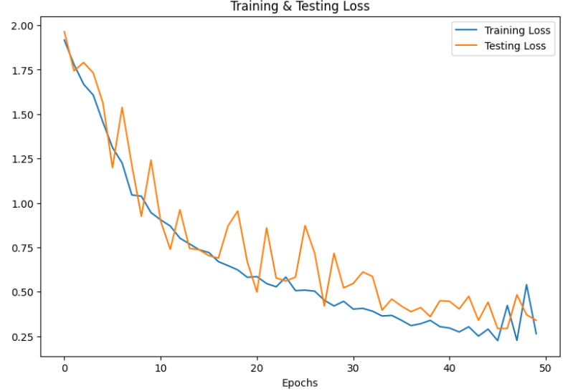
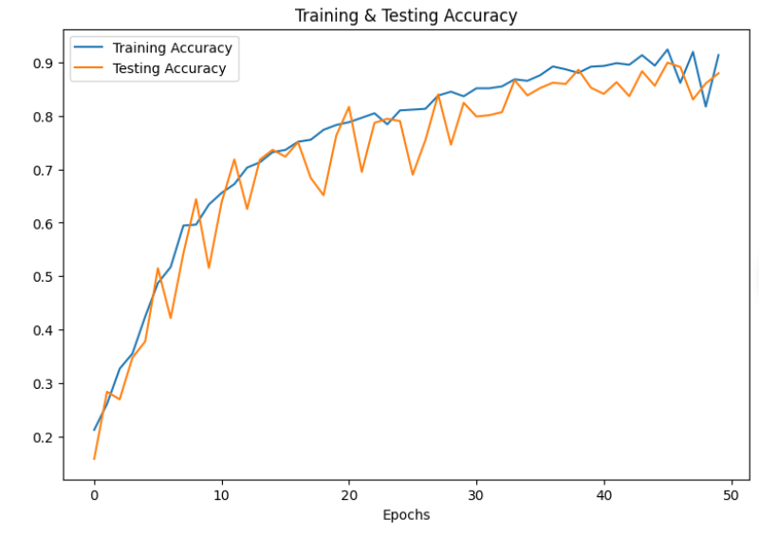
Model Evaluation

Slide 7
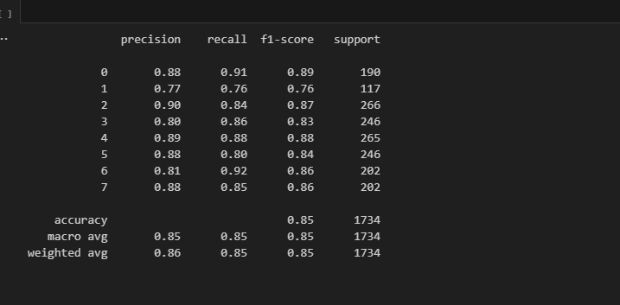
Model Evaluation

Slide 8
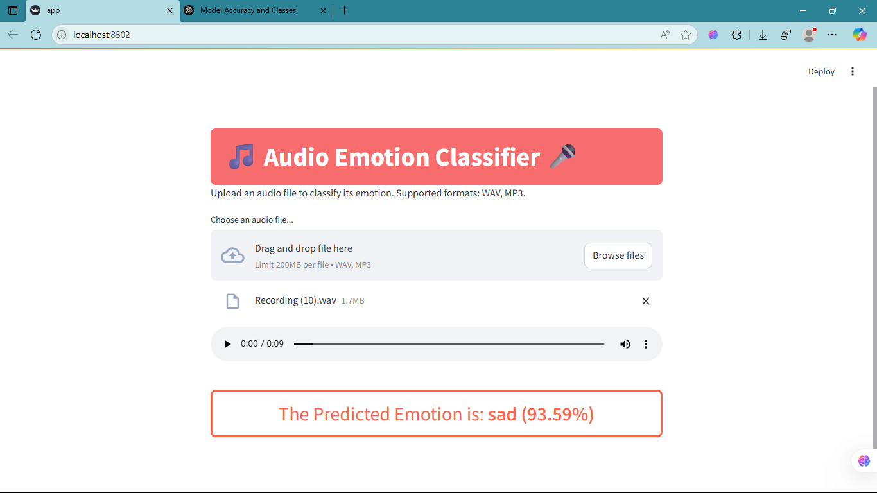
Streamlit Application
User-friendly web interface
Upload .wav or .mp3 audio files
Real-time emotion prediction
Displays confidence
scores and visualization Deployed using Streamlit
framework
The application allows non- technical users to easily access the emotion recognition capabilities.
Emotion Recognition from Speech
Muzamal, Faraz, Ans

Slide 9
Future Scope & Applications
Applications
Healthcare: Patient mood monitoring Customer Service: Call center sentiment analysis
Education: Adaptive teaching methods Virtual Assistants: More empathetic
interactions
Entertainment: Emotion-responsive gaming
Future Improvements
Multi-language support Detect mixed emotions
Improve accuracy for noisy environments Reduce model size for mobile deployment
Integrate with other modalities (facial expressions)
Emotion Recognition from Speech
Muzamal, Faraz, Ans

Slide 10
Thank You
CNN achieved 85% accuracy in emotion recognition Successfully deployed as a user-friendly application
Demonstrates the power of deep learning for speech analysis
Emotion Recognition from Speech
Faraz ,Muzamal,Ans

